Slide 2
Harbor: enterprise cloud native artifact registry
Yan Wang, VMWare
Daojun Zhang, VMWare
Shengwen Yu, VMWare
Vadim Bauer, 56K.Cloud

Slide 3



Title
Harbor
Harbor is an open source trusted cloud native registry that stores, signs, and scans content. The mission is to provide cloud native environments the ability to confidently manage and serve container images and related artifacts.
https://github.com/goharbor/harbor
https://goharbor.io

Slide 4
Key Features
Access control
RBAC
Project isolation
Management policy
Immutability
Quotas
Retention
Artifact distribution
Replication
Proxy cache
P2P preheat
Security & Compliance
Signing
Scanning
CVE allowlist
Extensibility - Compatible with existing investments in infra & services
Integration with LDAP, OIDC provider for authentication
Robot Accounts
Webhook

Slide 5

V2.5 Recap
New Feature
Integrate Harbor with Cosign
Artifact accessory
Tag retention with cosign signature
GC with cosign signature
Artifact replication with cosign signature
Improvements
There are additional improvements in Harbor v2.5.0
Improved performance for concurrent pull requests
Improved failure tolerance for garbage collection
Replication now supports skipping artifacts in a proxy cache project
Added distribution upload purging to remove orphaned files from the upload directory
Harbor is now built using Golang v1.17.7

Slide 6
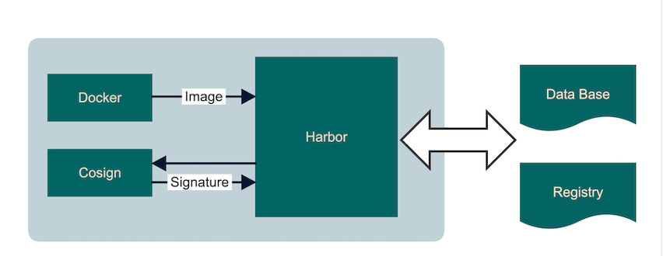
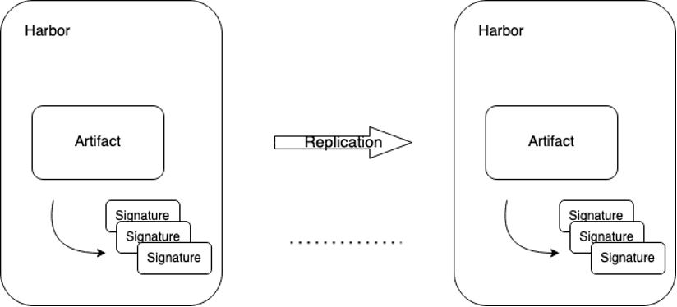
V2.5 Highlight - Cosign
Cosign Integration:
Support Cosign to sign a OCI artifact, and store signatures in Harbor.
Support replicate artifact signatures to another Harbor instance.
Signatures are considered not subject to garbage collection if they are associated with an existing artifact.
Policy enforcement to disallow pulling an unsigned image in Harbor.
Proposal: https://github.com/goharbor/community/blob/main/proposals/new/cosign-integration.md

Slide 7
V2.6 Ongoing Release

Slide 8
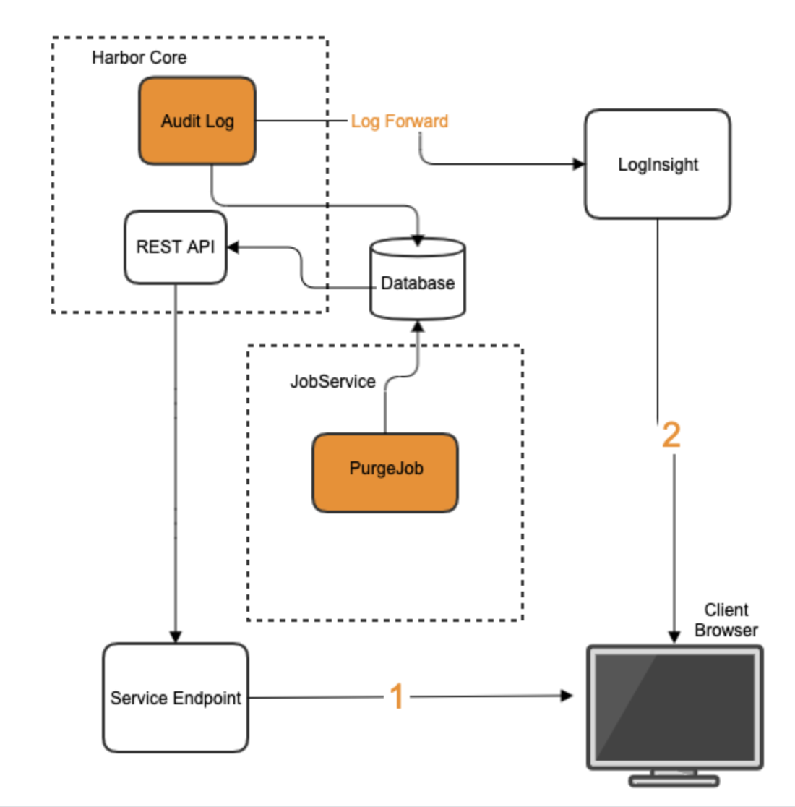
V2.6 Audit Log
Audit Log:
Support admin configurate audit log purge schedule, view history.
Support forward the audit log to the external service.

Slide 9
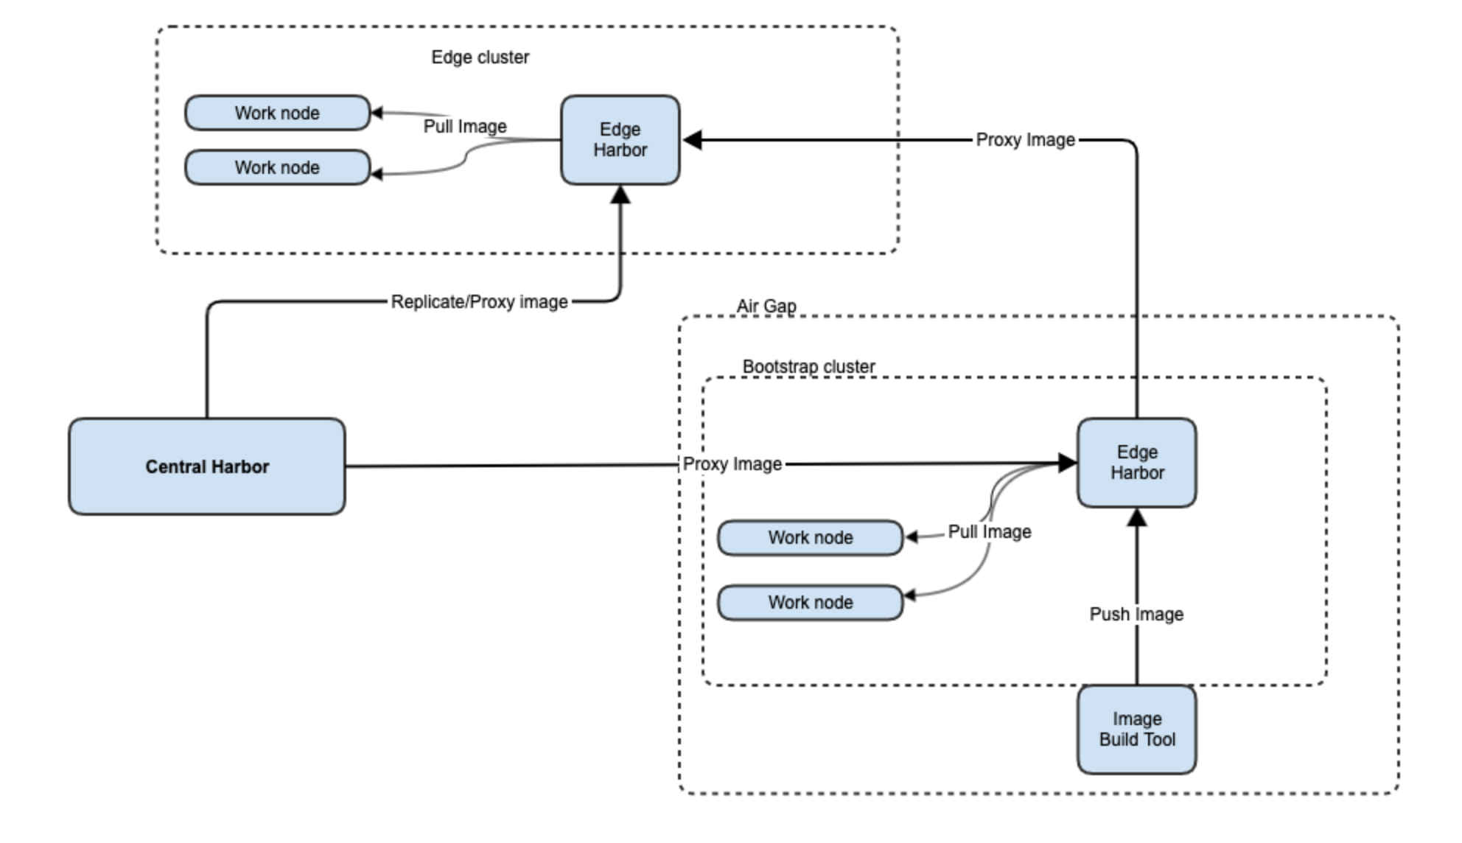
V2.6 Edge Registry

Slide 10


Demo time: Cosign

Slide 11
Roadmap
Roadmap
Theme | Description | Timeline
Harbor Lite for Edge | Create a lightweight Harbor with reduced feature set for minimal footprint | 2022 H2
Deployment | Improve Kubernetes Operator for Harbor, enabling improved Day1 and Day2 operations including enterprise grade HA, faster deployments and upgrades, automate backups and restores, and sensible defaults | 2022 H2
Optimized scalability | Improve the throughput and response latency in high concurrency scenarios especially for high concurrency pulling images, by introducing cache layer | 2022 H2
Backup & Restore | Leverage Project Velero to offer application-aware Harbor backup, including databases, Kubernetes objects and Persistent Volumes | 2022 H2
Multiple Database | Multiple Database support allows user to attach different type of database to Harbor, like PostgreSQL, MariaDB/MySQL, etc. | 2023 H1

Slide 12
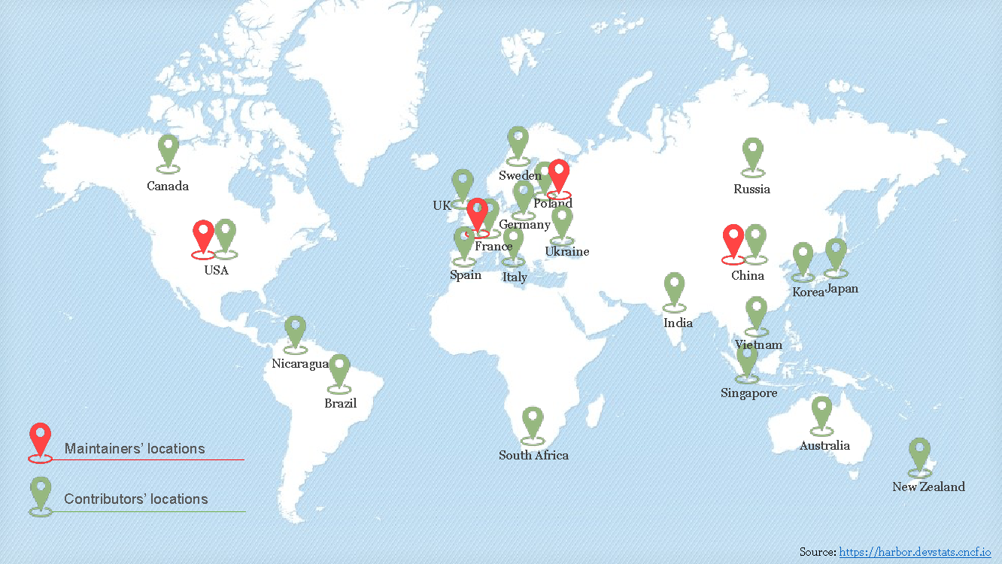
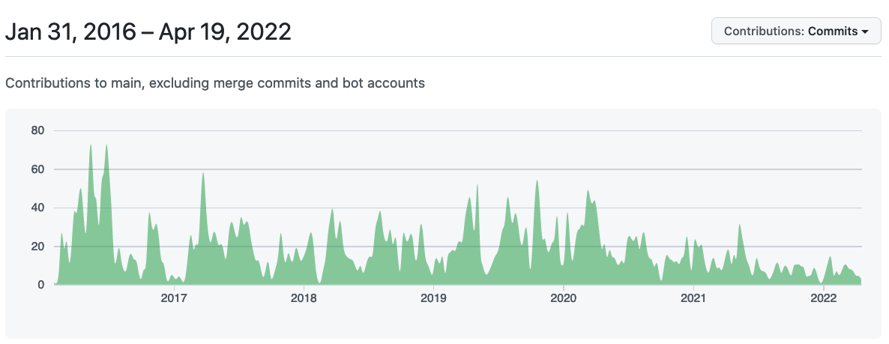
Harbor Community - Thriving
GitHub Stars
Committers
Contributing Companies
Contributors
Forks
17.2K+
230+
50+
3000+
4100+
Commits
GitHub Views/Visitors(2w)
Downloads
13 Maintainers across 7 companies
12K+
70K/18K+
18K+
Harbor Community
data source: https://harbor.devstats.cncf.io/ & https://github.com/goharbor/harbor/graphs/traffic (till 2022/04/19)

Slide 13

Workgroups
Workgroups
Workgroup is a virtual team focusing on a specified topic and delivers features related to the topic by aggregating efforts across all the interested parties.
WG: Multiple DB
Enable Harbor to support multiple database
Proposal: https://github.com/goharbor/community/pull/188
Slack: #harbor-multi-database-group
WG: Image acceleration
Introduce and integrate accelerated image format support into Harbor
General image acceleration service: https://github.com/goharbor/acceleration-service
Slack: #harbor-image-accelerator
Notes:
Next I'd like to share something about the workgroups that are driven by the Harbor community.
"Workgroup is a virtual team focusing on a specified topic and delivers features related to the topic by aggregating efforts across all the interested parties.
"
Till now, Harbor community has 7 workgroups already.
Some early formed workgroups have already delivered many key features, including: replication by the replication group, P2P distribution framework by the P2P workgroup and pluggable scanning by the scanning workgroup.

Slide 14






Collaboration
Collaboration
#harbor
#harbor-dev
slack.cncf.io
lists.cncf.io/g/harbor-users
lists.cncf.io/g/harbor-dev
Demo Environment
01
02
demo.goharbor.io
Self-registration
03
04
https://github.com/goharbor/community/blob/master/MEETING_SCHEDULE.md
@project_harbor

Slide 15
Thank You

